Slide 1

Asset Management Planning & Asset
Retirement Obligation Management
Using
SAP Analytics Cloud (SAC)

Slide 2

Webinar Agenda
01
02
03
Introduction to VIZIO Consulting
Demo 1:
Asset Management Planning
Demo 2:
Asset Retirement Obligation Managment
04
Closing Remarks
Q&A
05
2

Slide 3

Presentation Disclaimer
• SAP Analytics Cloud platform is the sole registered property of SAP.
• VIZIO Consulting offers implementation services on SAC.
3

Slide 4

Section 1: Introduction to VIZIO Consulting
4

Slide 5

Welcome to VIZIO Consulting
• Vizio Consulting is a boutique SAP consulting firm operating in Canada and
the US.
• We specialise in BI, Analytics & FP&A solutions.
• We offer End-2-End implementation & support services.
Know more
5

Slide 6
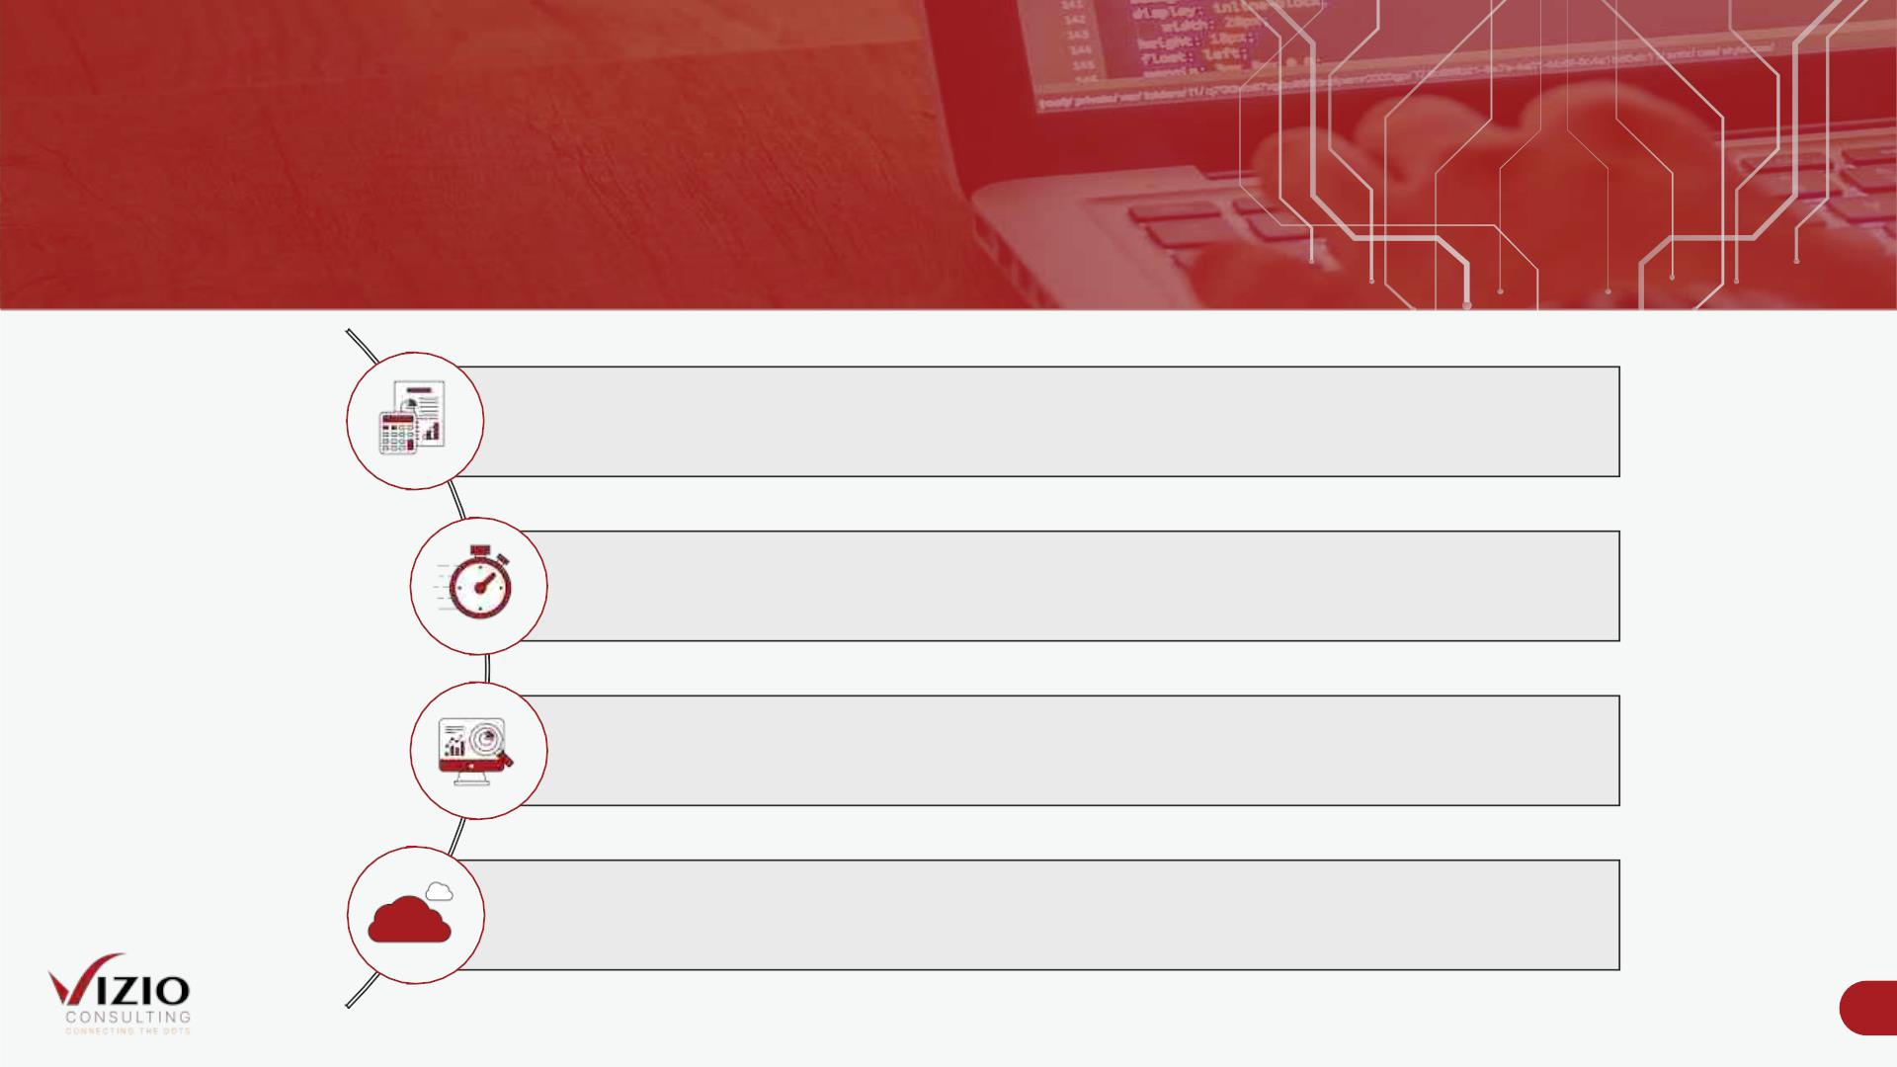
VIZIO‘s FP&A Accelerators
Pre-built FP&A processes based on best practices
Rapid deployment due to 80% - 90% process pre-built solution
Demo ready to get real time FP&A automation experience
Built on the SAP Analytics Cloud platform (SAP SaaS)
6

Slide 7
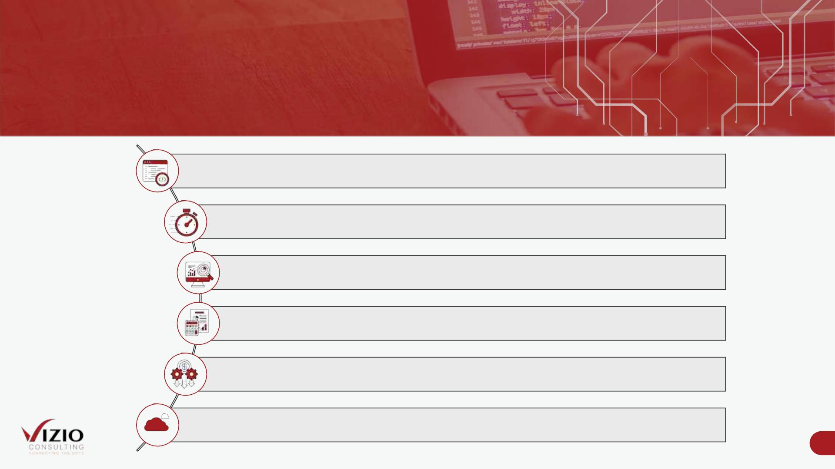
Value Proposition For Municipalities
Why Use VIZIO's FP&A Accelerators
Built as a one size fits all FP&A Solutions
Short implementation cycles (8 – 16 weeks)
Present SAC as a planning and budgeting tool and business application development
tool
Showcase SAC as a viable replacement of Excel and other manual planning tools
In advance 80% - 90% of standard planning processes to reduce implementation cost
significantly
SAP SAC as a service provides flexible licencing options
7

Slide 8
Section 2:
DEMO 1 - Asset Management Planning
8

Slide 9
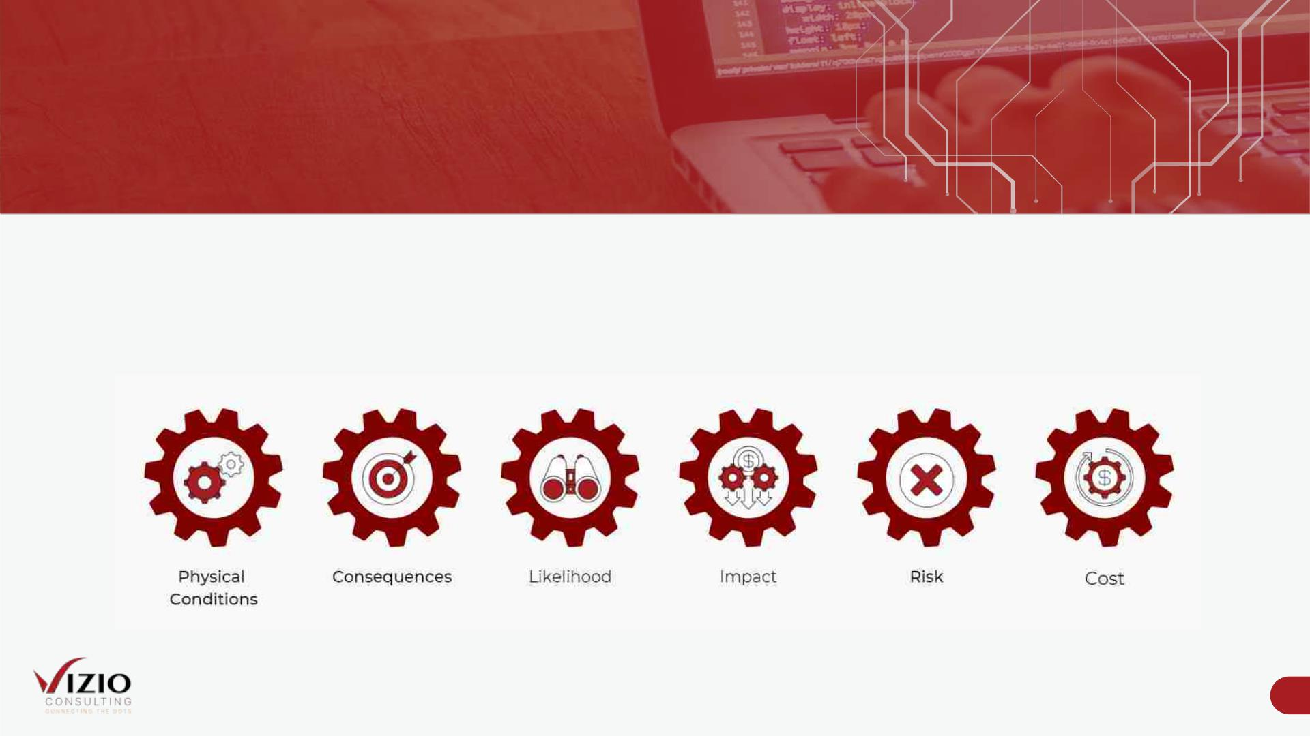
Meeting Business Needs With VIZIO's Asset Management Planning
Accelerator
• VIZIO’s planning solution makes the process straightforward, logical, and quantifiable.
• Our Asset Management Planning lifecycle contains the following components:
9

Slide 10
LIVE DEMO 1
10

Slide 11
Section 3 :
DEMO 2 - Asset Retirement Obligation Management
11

Slide 12
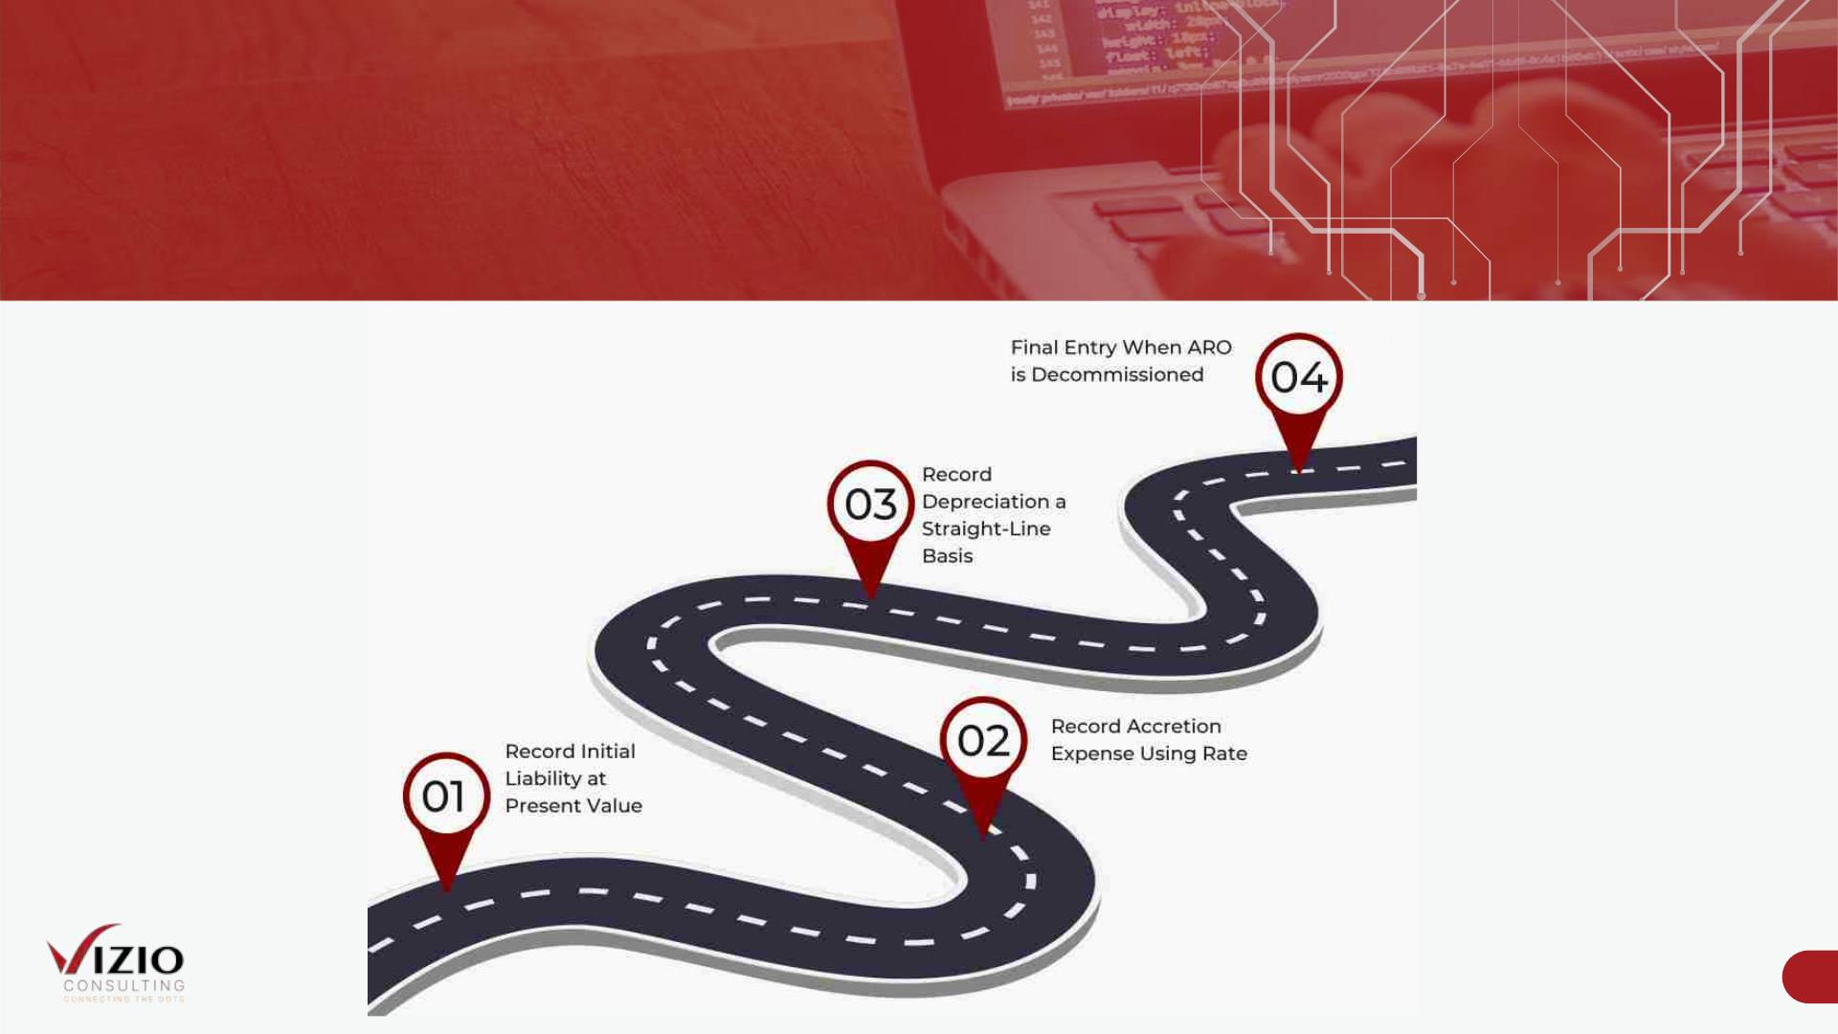
What is Asset Retirement Obligation Management
12

Slide 13
LIVE DEMO 2
13

Slide 14
Section 4: Closing Remarks
14

Slide 15
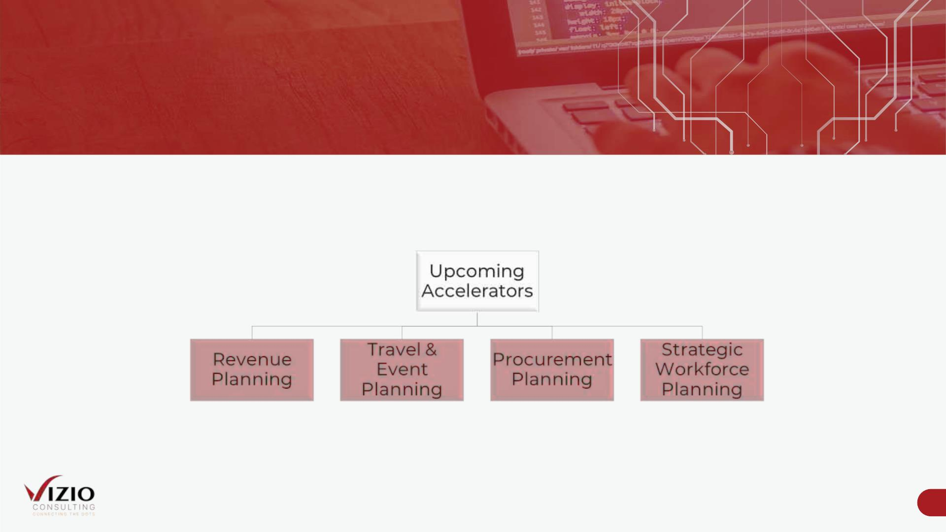
Upcoming Planning Accelerators on SAP SAC
VIZIO’s future pipeline includes the following accelerators:
15

Slide 16
Section 5: Q&A
16

Slide 17

Let's Connect!
Asma Asaf
Sajjad Hassan
Project & Event Manager
SME FP&A Solutions
asma.asaf@vizioconsulting.com
sajjad.hassan@vizioconsulting.com
+1 (289)-952-8845
info@vizioconsulting.com
+1 (289)-813-9135
2 Robert Speck Parkway, Suite 750 Mississauga, ON L4Z
1H8 Canada
www.vizioconsulting.com
t
l
y

Slide 18
Appendix A
18

Slide 19
Detailed Disclaimer
• SAP Analytics Cloud is the sole registered property of SAP. For more information about SAP Analytics Cloud please refer to:
https://www.sap.com/canada/products/cloud-analytics/features.html
• Vizio Consulting is using SAP Analytics Cloud as a running platform for all our planning templates and content.
• The template you will be viewing in today's demo is a basic format of our solution. It can be enhanced and expanded to meet
the individual needs of each client with minimum effort. Keeping this in mind, implementation timelines for each project are
impacted by data sets and conditions provided by each respective client.
• The information in this presentation is not a commitment, promise or legal obligation to deliver any code, material or
functionality.
• This presentation is for informational purposes only and may not be incorporated in any contract.
• All forward statements are subject to various risks and uncertainties that could cause actual results to differ materially from
expectations.
19

Slide 20
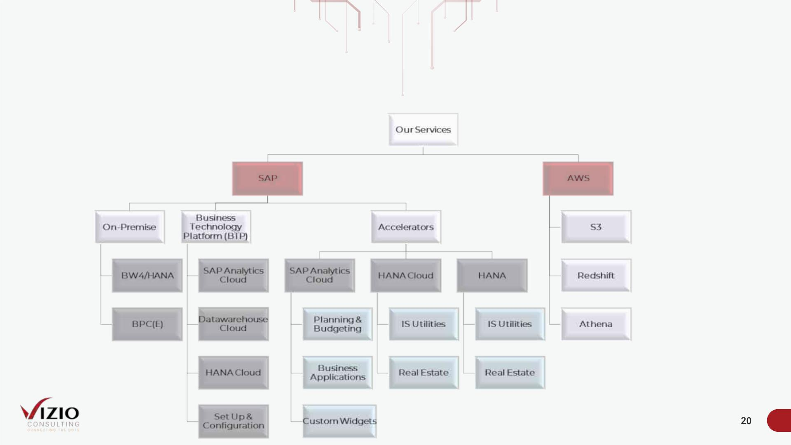
VIZIO's Services
We have expertise ranging from designing complex BW4HANA, BPC Embedded, SAC models and creating insightful reports and critical decision
support analytics.

Slide 21
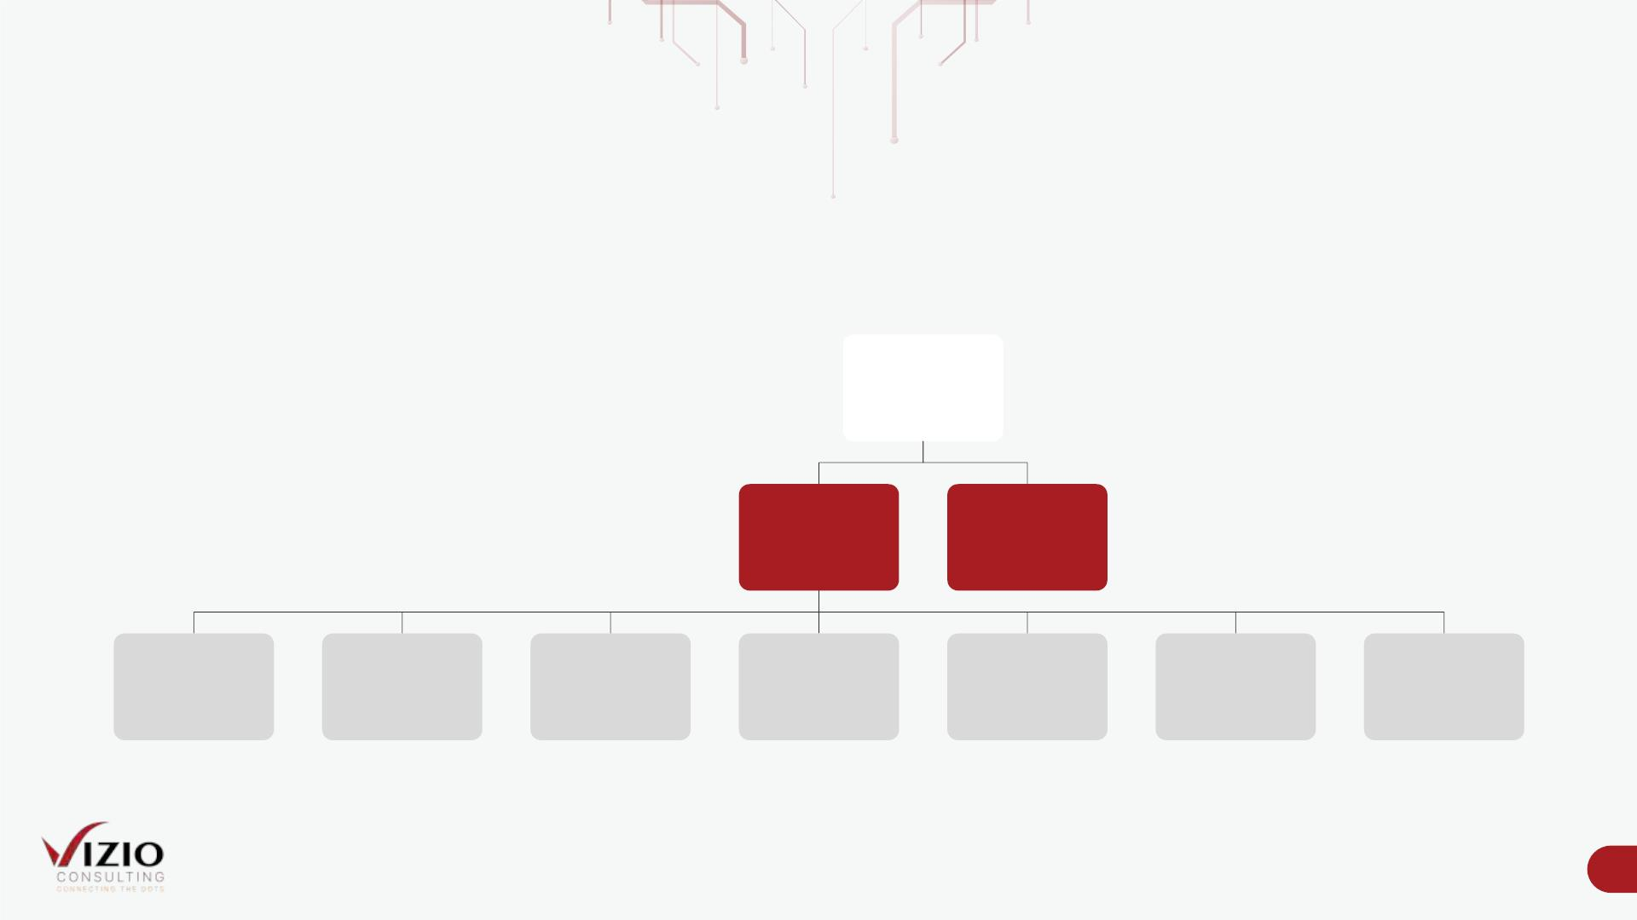
Planning & Budgeting Accelerators Built on SAP SAC
Our planning & budgeting accelerators, built on the SAP Analytics Cloud platform, can be divided as follows:
SAP Analytics
Cloud
Planning &
Budgeting
Custom
Widgets
Workforce
Planning
Salary &
Benefits
Planning
Ongoing
CAPEX
Planning
New Capital
Project
Planning
Asset
Management
Planning
Profitability
Planning
OPEX Planning
21

Slide 22

Business Application Built on SAP SAC
Using the SAP Analytics Cloud platform, we have built our Asset Retirement Obligation Management Template as a business
application
SAP Analytics
Cloud
Business
Application
Asset
Retirement
Obligation
Management
22

Slide 23
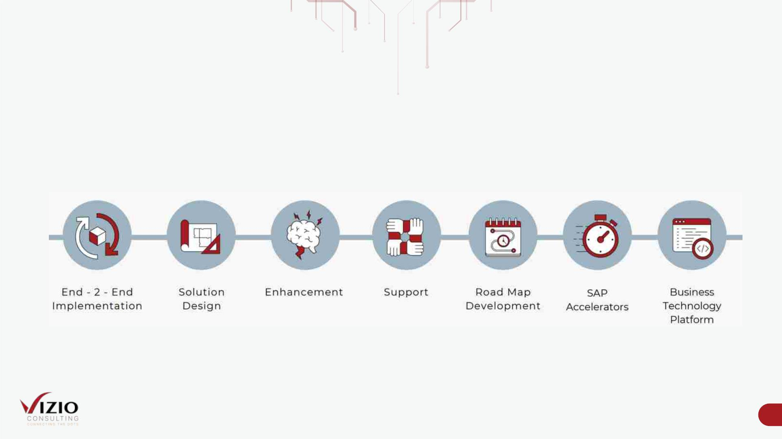
VIZIO's SAP Capabilities
We offer end-to-end services which includes
23

Slide 24
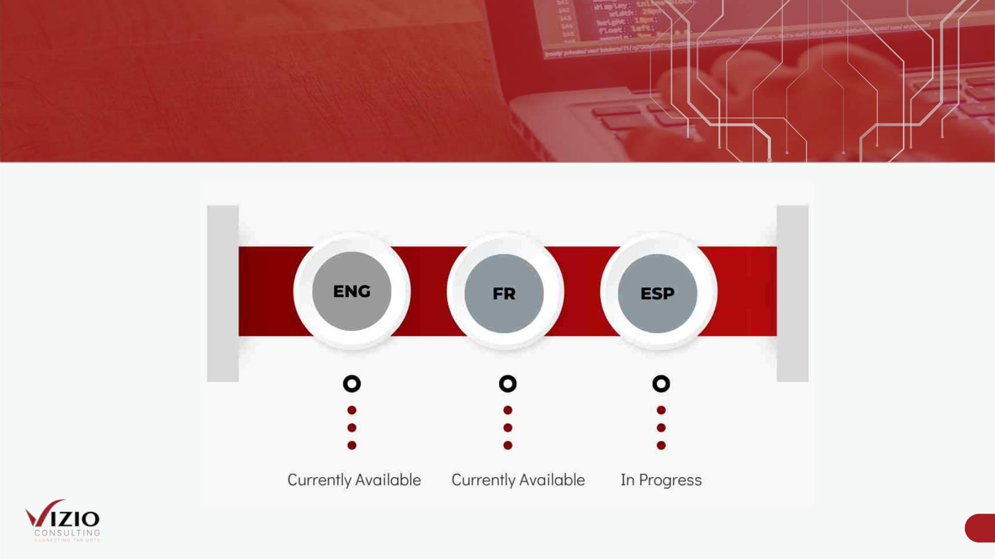
Multilingual Solutions
24

Slide 25
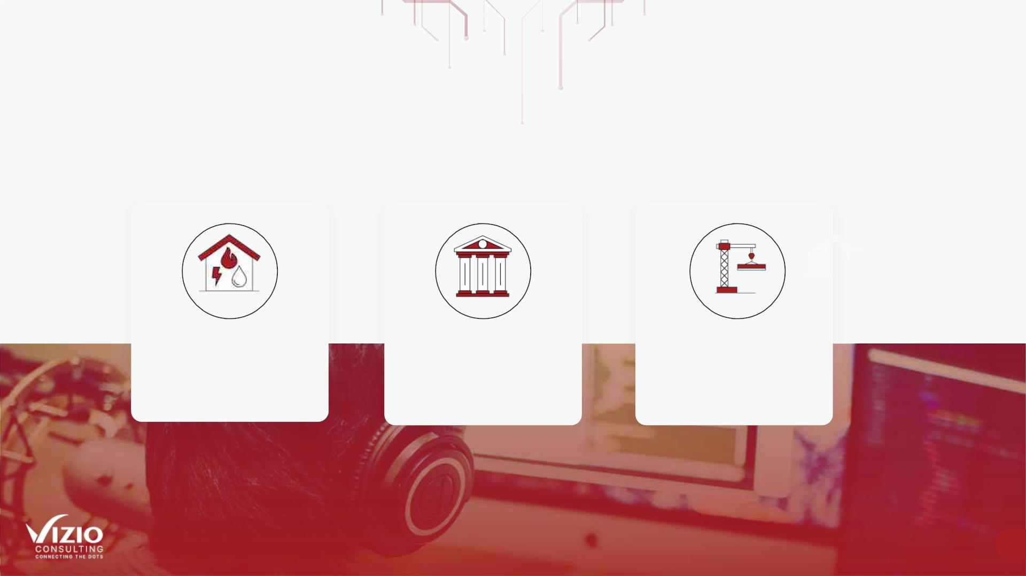
VIZIO Industry Experience
The team at VIZIO Consulting has several years of experience working in (but
not limited to) the following industries:
Utilities
Public Sector
Manufacturing
25

Slide 26
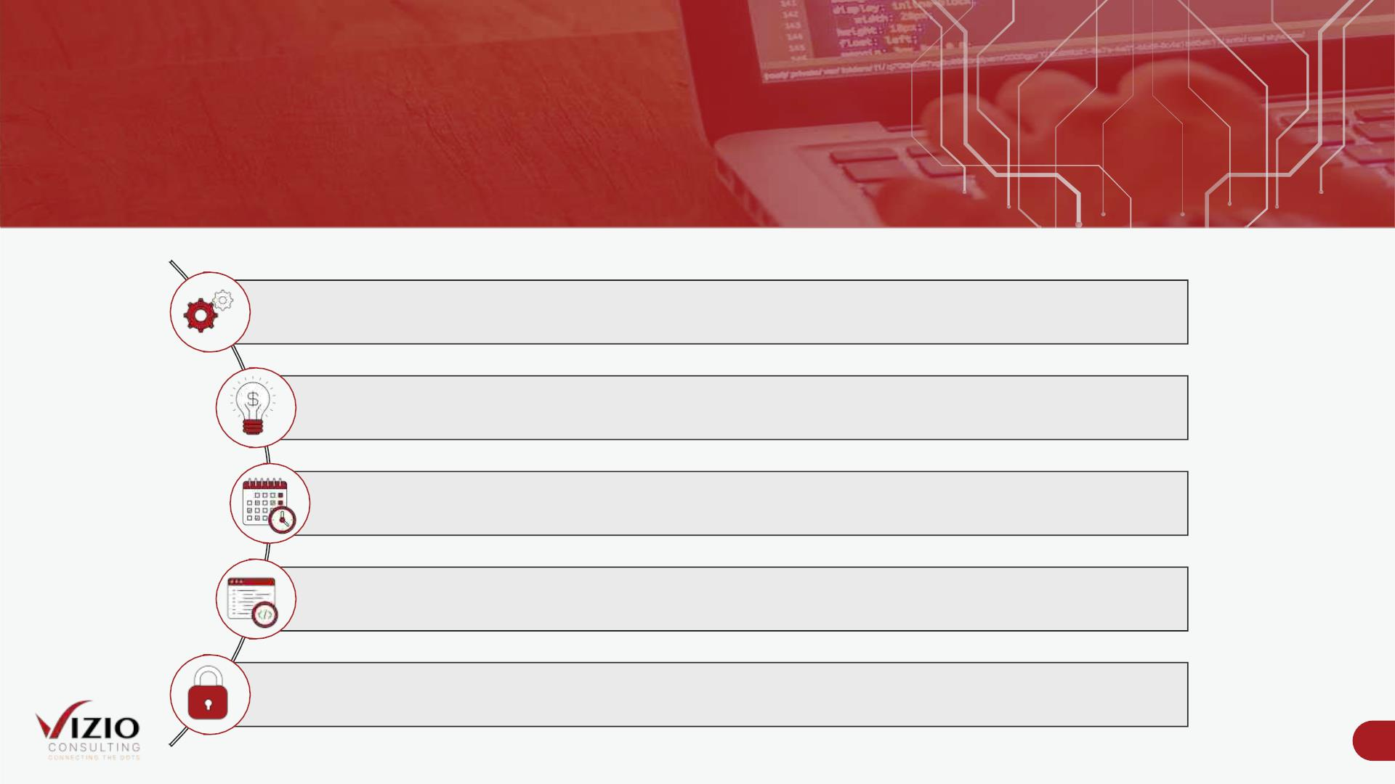
VIZIO‘s Accelerators
Key FP&A Features for Municipalities
Full Driver Based Processes
What If Analysis
Multi Year Budgeting (Max 10 Y)
Full Process Tracking
Data Level Security
26

Slide 27
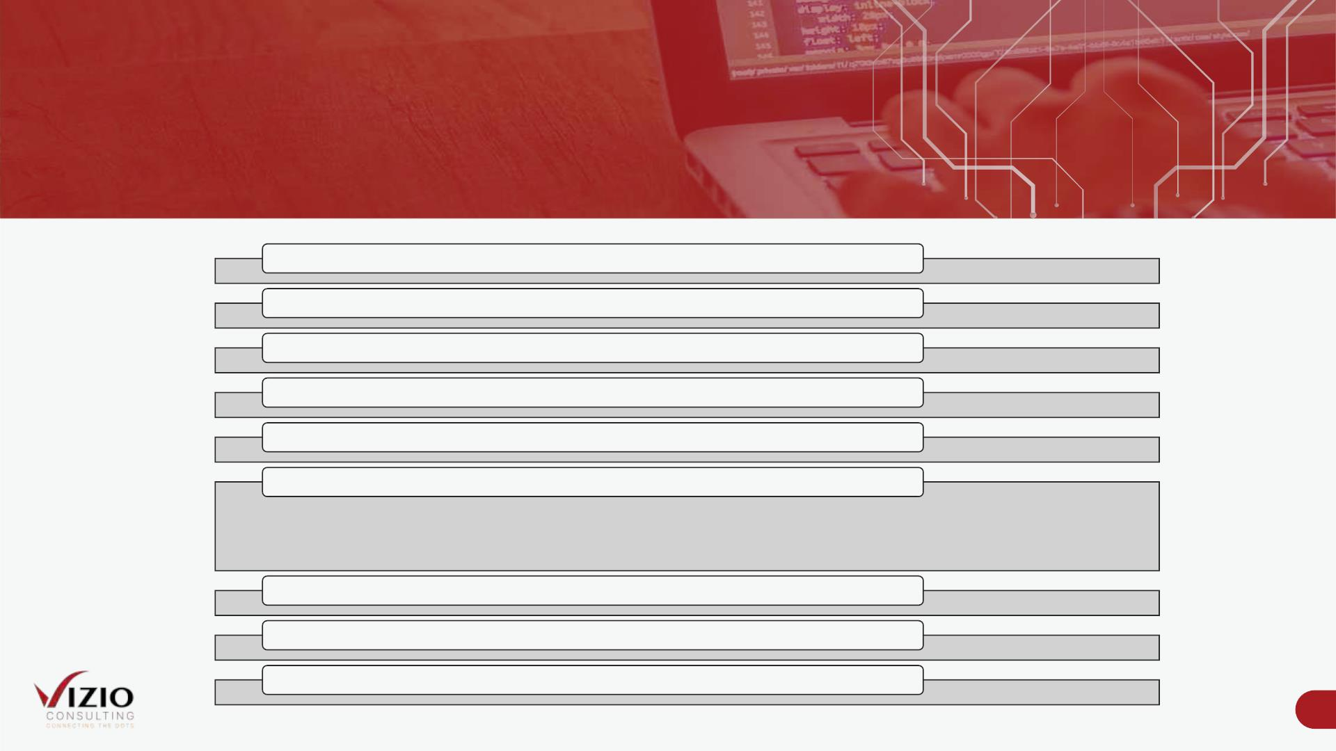
ARO Design Features
Obligation Management
Cost Estimates
Future Value & NPV
Depreciation Calculation
Cashflow Generation
Posting entries
•Obligation
•Asset
•Depreciaton
•Sale of an Asset
Physical asset linking
Able to use different discount rates
Able to handle multiple legal entities
27

Slide 28
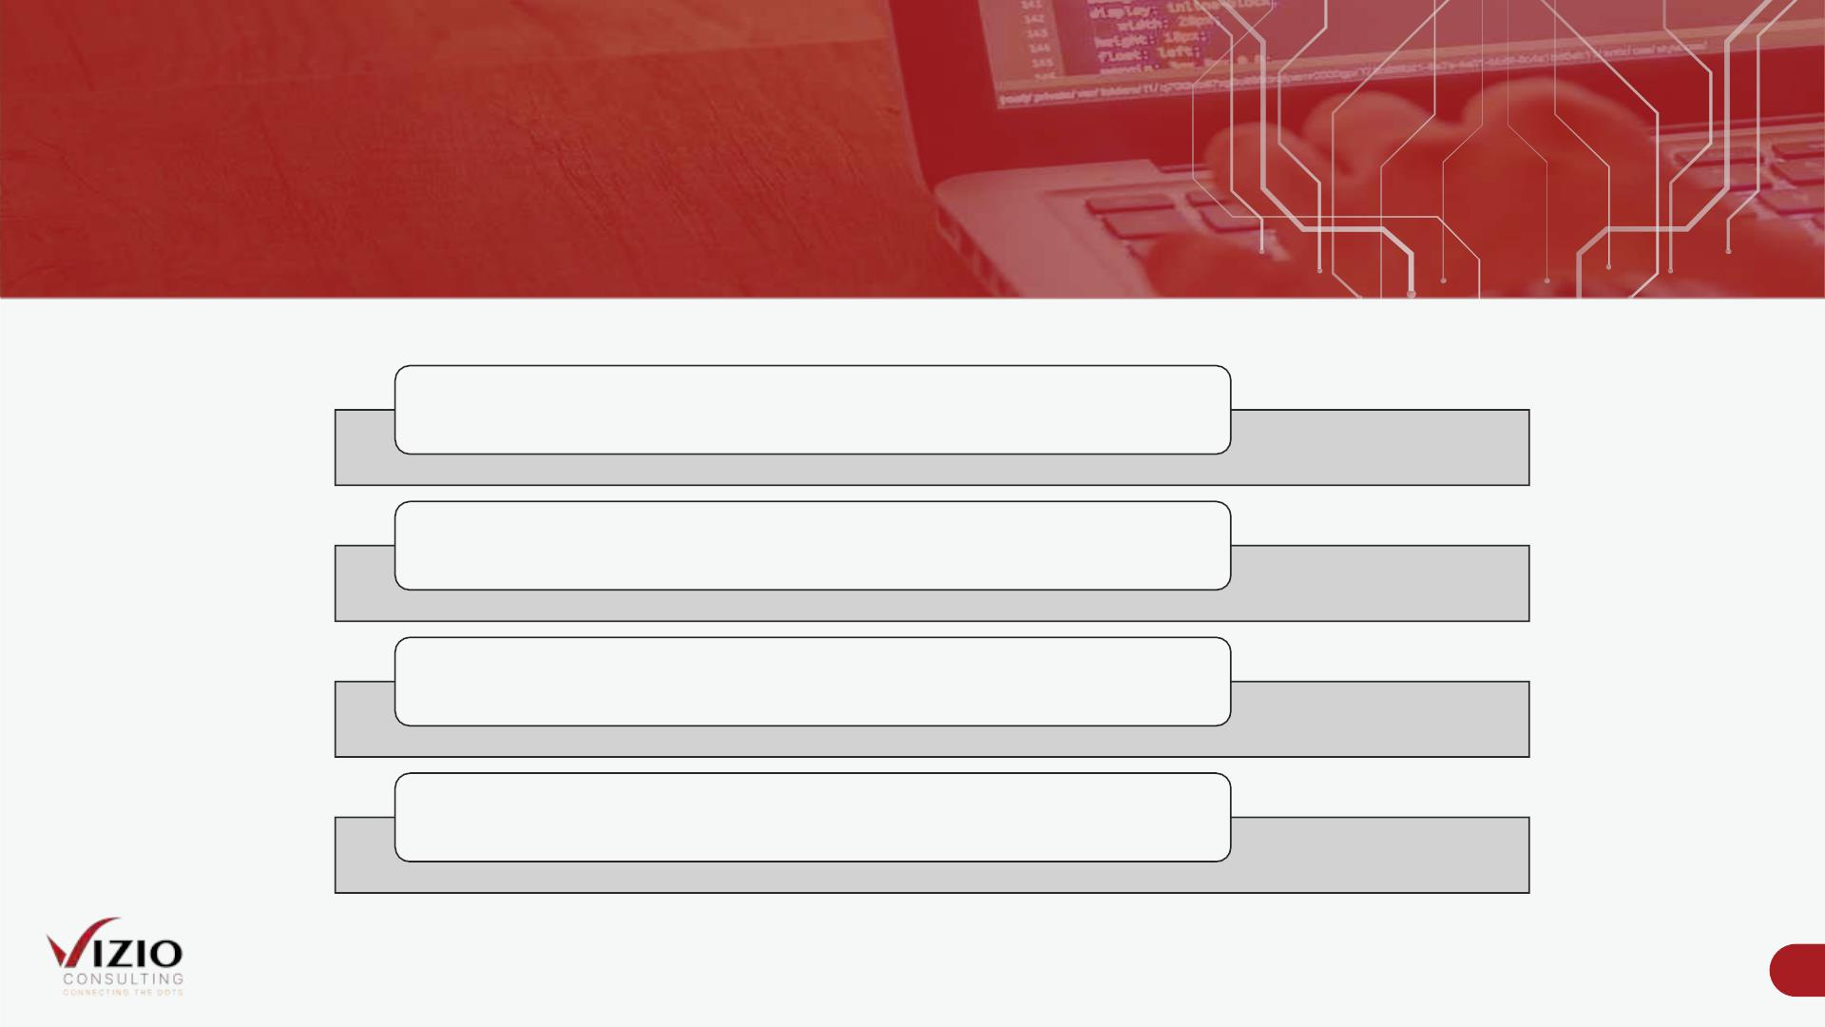
ARO Special Pricing Model For Municipalities
Benefits of a Subsciption Based Pricing Model
No Up-Front Implementation Cost
Monthly Subscription to Use Our Templates
Fully Managed Solution by VIZIO
Enhancement & Training by VIZIO
Disclaimer:
This subscription-based model is for VIZIO ‘s ARO Template usage on the SAP SAC Platform only. It does not include SAP licensing cost.
28

